Slide 1

Customer Shopping Behavior Analysis
Analyzing 3,900 purchases to uncover insights into spending patterns, customer segments, and product preferences that drive strategic business decisions.

Slide 2
DATASET OVERVIEW
Understanding Our Data
3,900
18
50
25
Total Purchases
Data Points
Locations
Products
Transactions analyzed across all categories
Features tracking customer behavior
Geographic distribution of customers
Unique items purchased
Dataset includes customer demographics, purchase details, shopping behavior metrics, and subscription status. Only 37 missing values in Review Rating column.

Slide 3


PYTHON ANALYSIS
Data Preparation & Cleaning
01
Data Loading
Imported dataset using pandas for initial exploration
02
Missing Data
Imputed Review Rating nulls using median by category
03
Standardization
Renamed columns to snake_case for consistency
04
Feature Engineering
Created age_group and purchase_frequency_days columns
Cleaned data was loaded into PostgreSQL database for structured SQL analysis and business intelligence.

Slide 4
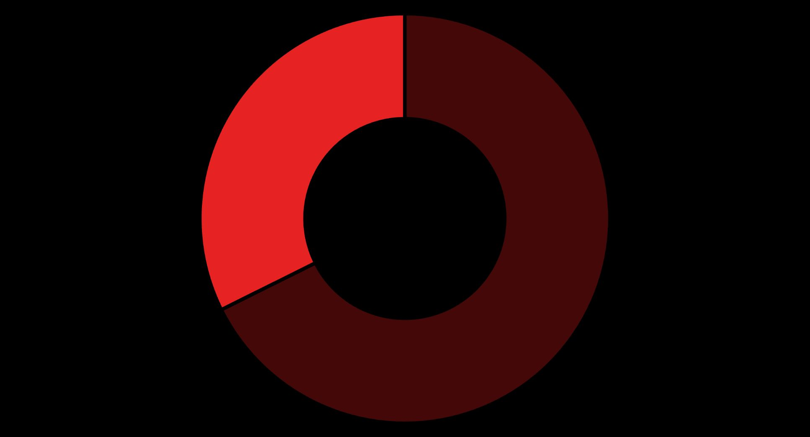
SQL INSIGHTS
Revenue Analysis by Gender
Male
Female
Male customers generate 68% of total revenue ($157,890) compared to female customers at 32% ($75,191). This significant gap suggests opportunities for targeted marketing to female demographics.

Slide 5
Top Products & Customer Preferences
Highest Rated Products
Discount-Dependent Items
Gloves
50%
Average rating: 3.86
Hat
Sandals
49.66%
Average rating: 3.84
Sneakers
Boots
49.07%
Average rating: 3.82
Coat
Hat
Average rating: 3.80
48.17%
Sweater
Skirt
Average rating: 3.78
47.37%
Pants

Slide 6
Customer Segmentation Insights
Loyal Customers
Returning Customers
New Customers
3,116 customers
701 customers
83 customers
Highest segment representing repeat purchasers with strong brand affinity
Mid-tier segment showing potential for loyalty program conversion
Smallest segment requiring onboarding and engagement strategies
Analysis reveals 958 repeat buyers (>5 purchases) have subscriptions, while 2,518 do not—indicating significant subscription growth opportunity among loyal customers.

Slide 7

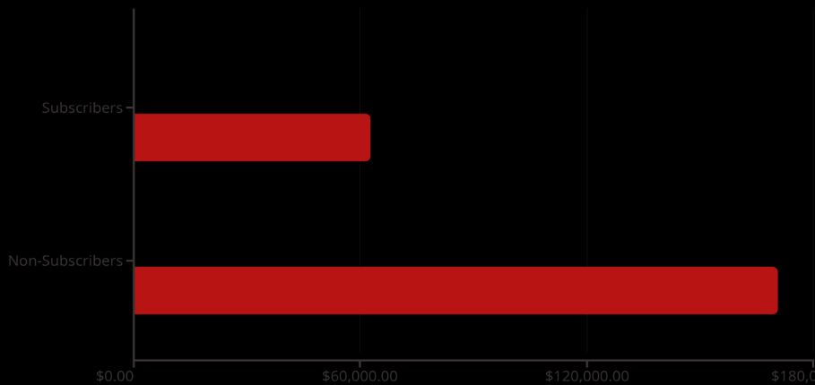

SUBSCRIPTION ANALYSIS
Subscribers vs. Non-Subscribers
Revenue Comparison
27%
Subscribers
1,053 customers
Avg Spend
Total Revenue
73%
Non-Subscribers
2,847 customers
Despite similar average spend, non-subscribers generate 73% of total revenue due to their larger population. Converting just 10% could significantly boost subscription revenue.

Slide 8
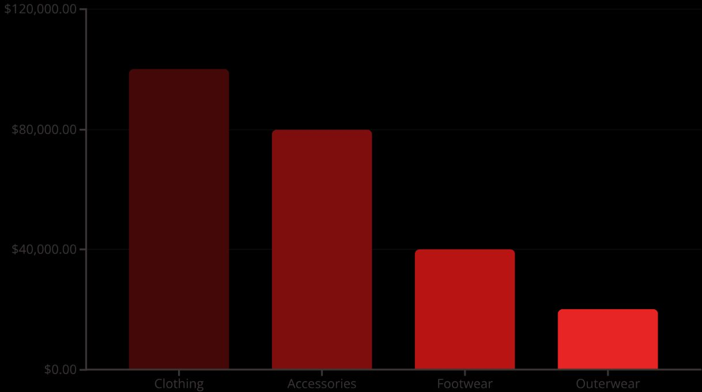
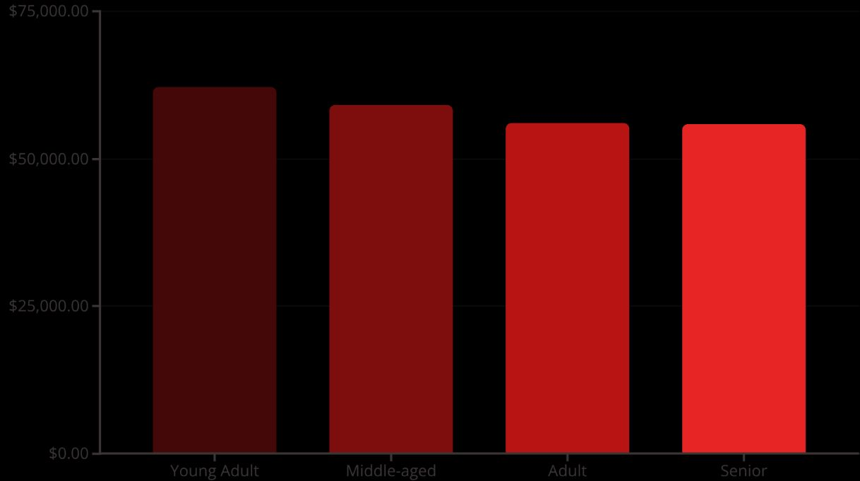
Revenue Distribution Analysis
By Category
By Age Group

Slide 9

POWER BI
Interactive Dashboard Overview
1
2
3
Key Metrics
Interactive Filters
Visual Analytics
3.9K customers, $59.76 avg purchase, 3.75 avg rating
Subscription status, gender, category, and shipping type
Revenue and sales breakdowns by category and age group
Dashboard enables real-time exploration of customer behavior patterns, supporting data-driven decision making across marketing and operations teams.

Slide 10



STRATEGIC RECOMMENDATIONS
Actionable Business Strategies
Boost Subscriptions
Loyalty Programs
Discount Strategy
Promote exclusive benefits to convert the 73% non-subscriber base
Reward repeat buyers to accelerate movement into "Loyal" segment
Balance promotional sales with margin control for sustainable growth
Product Positioning
Targeted Marketing
Highlight top-rated items (Gloves, Sandals, Boots) in marketing campaigns to drive conversion
Focus efforts on Young Adult segment and express-shipping users for maximum ROI

